Slide 2
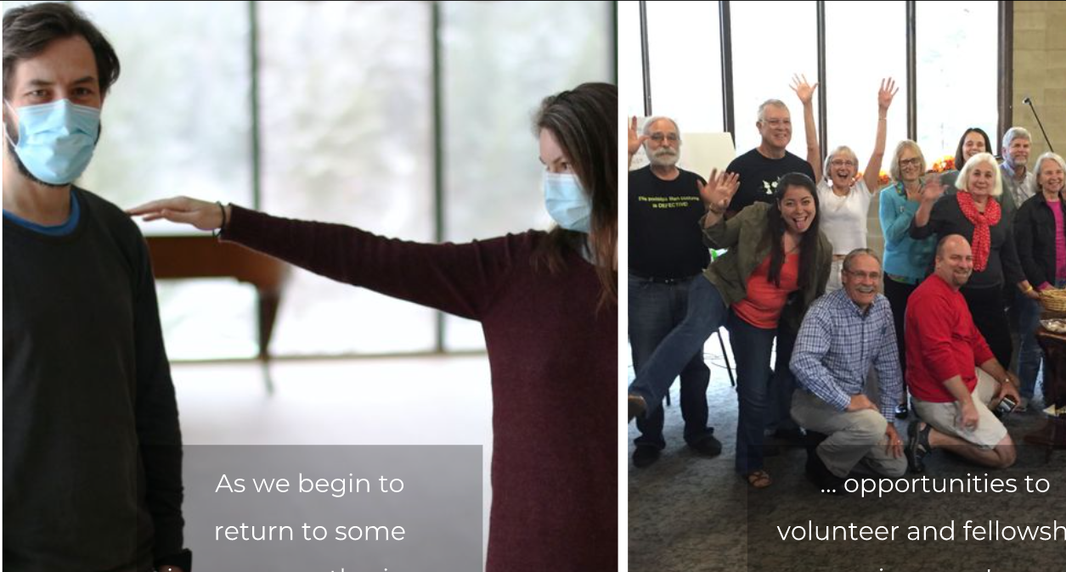

Slide 3
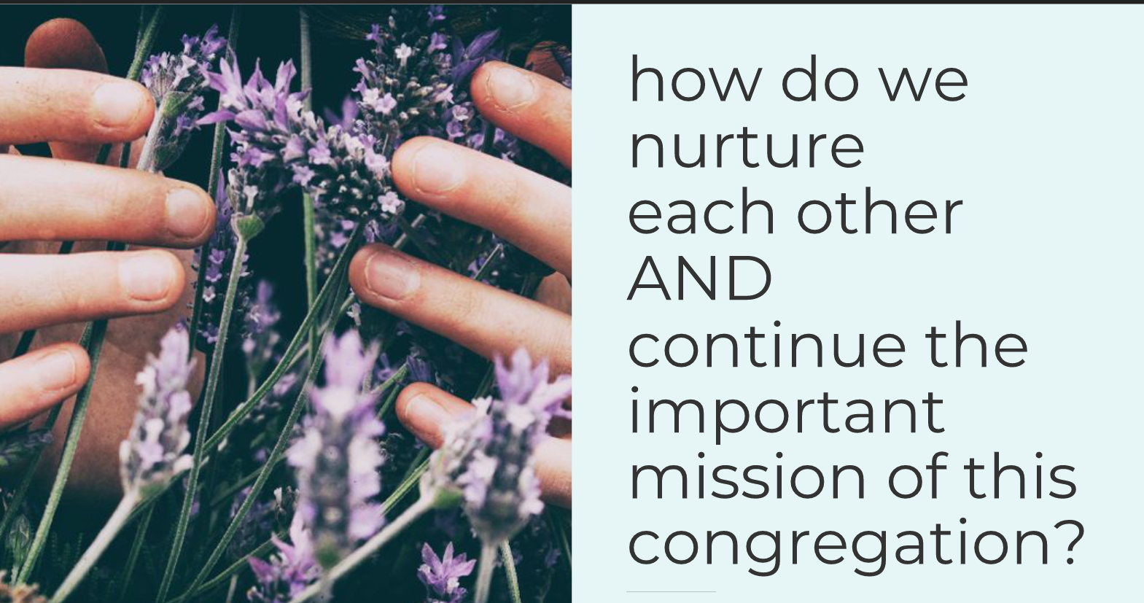

Slide 4
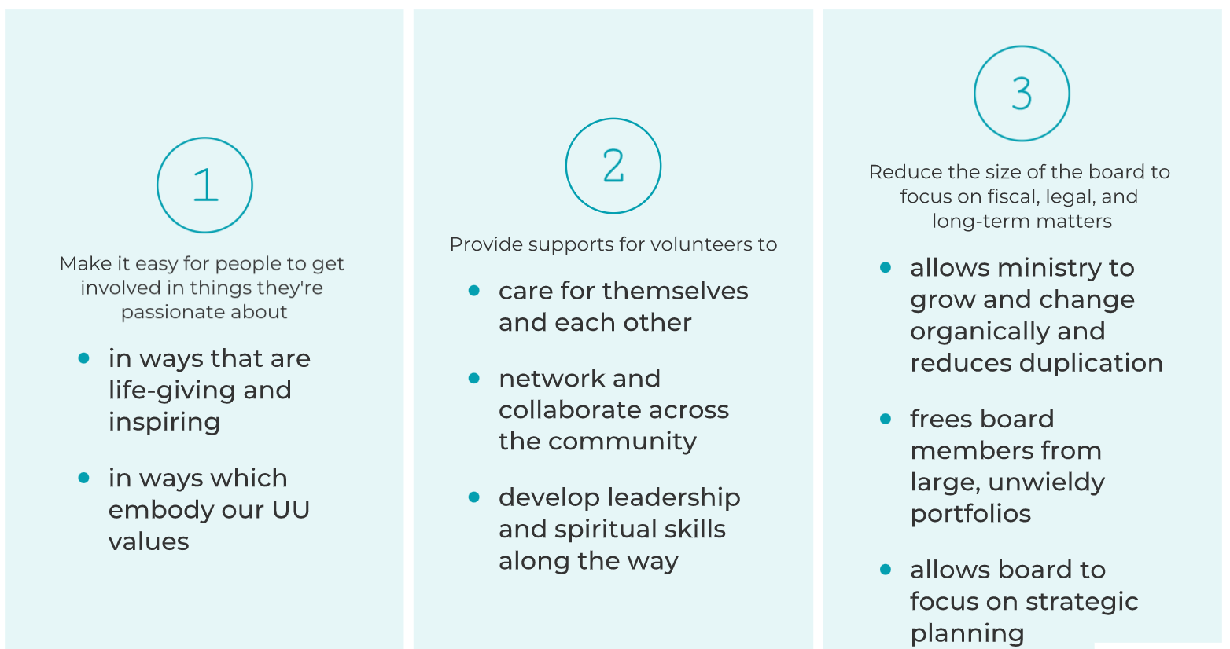

Slide 5
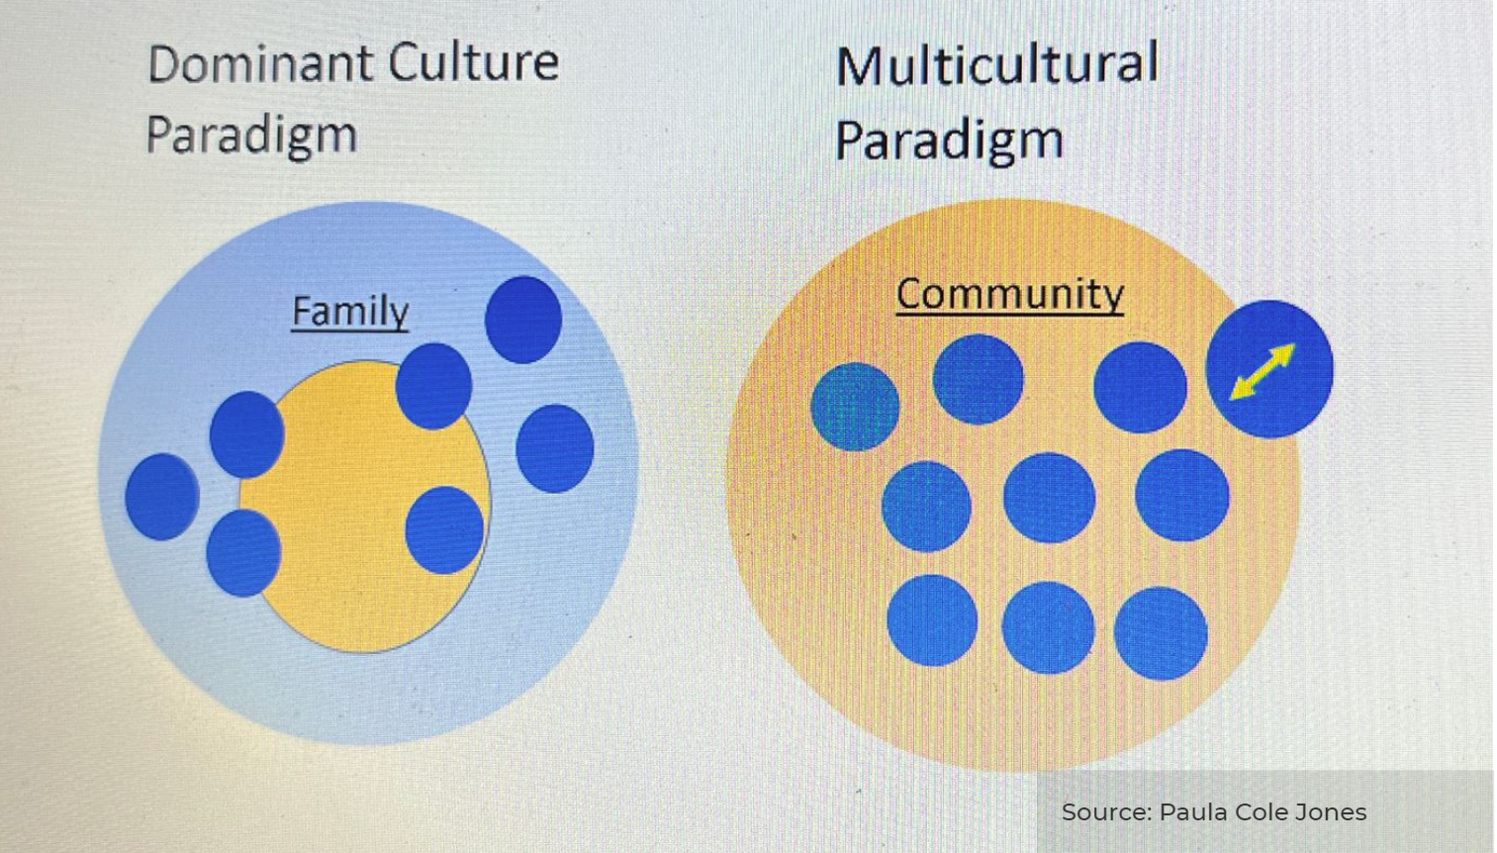

Slide 6
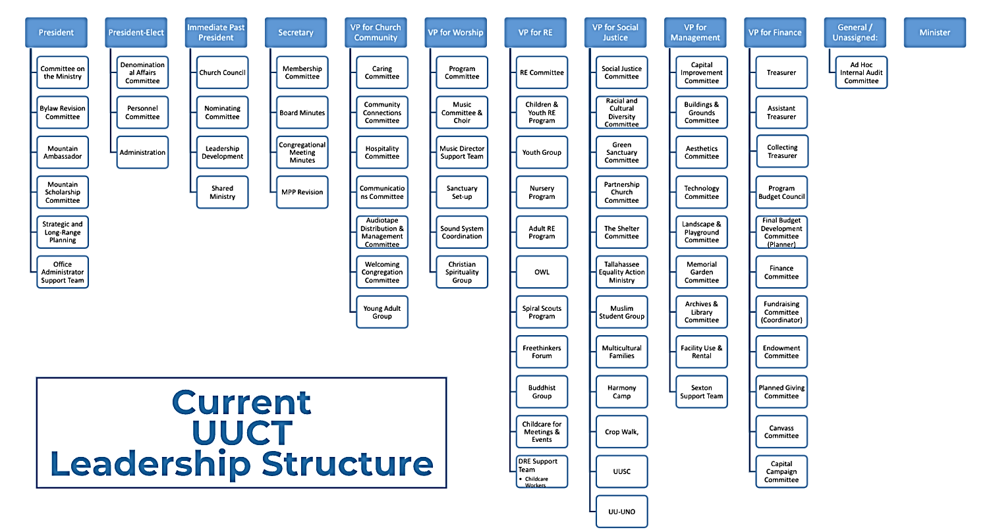

Slide 7
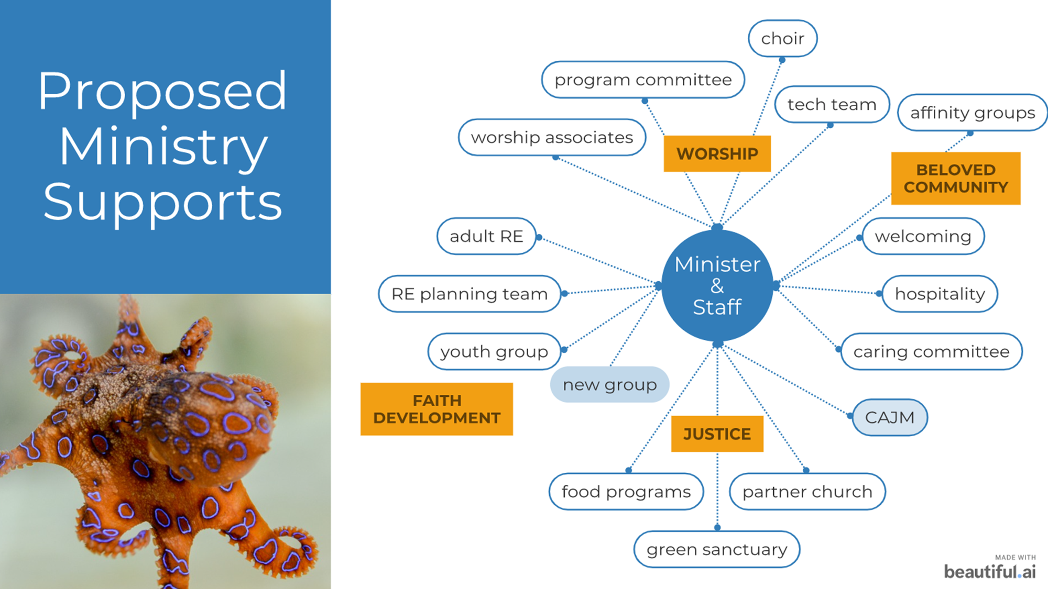
Notes:
Discuss that the Executive Board is focused on the mission and vision.
What’s shown here is how the “Day-to-Day” programs and ministries get done.

Slide 8
Notes:
Board focused on visioning and its key responsibilities: finance, personnel, endowment fund, COM.

Slide 12
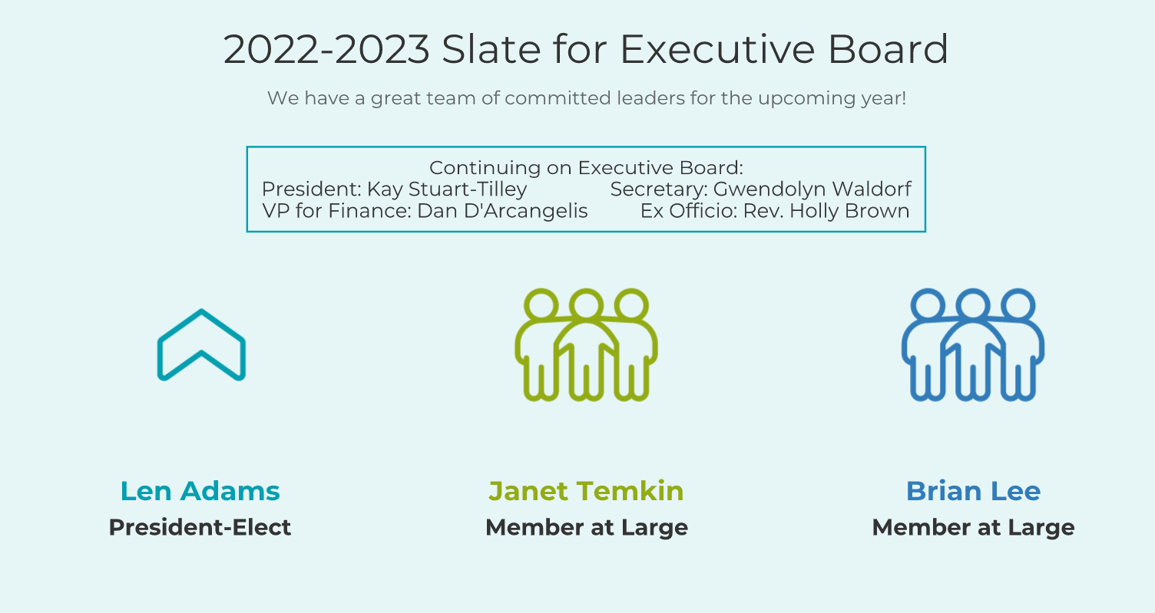

Slide 14
Nominating Committee’s Work
Reviewing the five “suspended” board positions
Volunteer recruitment and gifts of self
Brainstorm ways to highlight different groups within UUCT
Quarterly (at least) meetings for volunteers and leaders
Notes:
Work We’ve Been Doing:
Reviewing the five “suspended” board positions in consultation with the board and various other groups in the congregation.
Ensure that any critical tasks and responsibilities are clearly assigned to someone so they’re not missed.
Volunteer recruitment and gifts of self.
Collaborate with Membership Outreach & Canvass teams
Brainstorming ideas about ways to highlight different groups within UUCT.
Monthly appearances in service; presence after the service on veranda and/or digital coffee hour.
Quarterly (at least) meetings for volunteers and leaders.

Slide 15
Focus on Leadership Development
Board focus on mission/vision
Leadership development resources and opportunities
Gifts ministry – what feeds your soul?
Relationships and connection
Notes:
Develop leaders in the congregation

Slide 16
UUCT’s Current Process - Feedback
What are your concerns?
Is anything falling through the cracks?
What opportunities do you see?
Notes:
Discussion from the Group – opportunity to share opinions and fears, start thinking about opportunities.

Slide 17
What Difference Can We Make?
What part of the mission calls you to the work of the church?
How do we create an active, engaged, beloved community?
How does your group align with our mission/vision?
What impact have you felt/seen through your group?
Notes:
Discussion from the Group – try to move beyond what we’re concerned about to WHY we are doing this at all, what difference can we make, etc.
How do we become accessible to all kinds of people – and how do we become someplace they WANT to be?

Slide 18
Next Steps
Continue evaluation of board position descriptions
Continue outreach & engagement
Other congregations on their experiences
UUCT community
Consider bylaws changes (build on previous work)
Identify how developmental ministry could help continue the governance discussion

Slide 19
